Slide 1

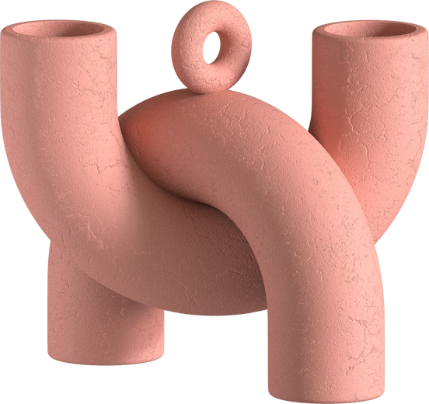

ChainMaster
Empowering Informed Decision-Making
Team Shallowbytes
Alekhya Gorugantu 16010420041
Guneet Sura 16010420075
Mayank Kulkarni 16010420102
Divya Nair 16010420103
Aditya Phatak 16010420127

Slide 2
Chain
Master
01
Intro to Options Chain
02
Problem Statement
03
Tech Stack
Index
04
Activity Diagram
05
Implementation
06
Unique Features

Slide 3
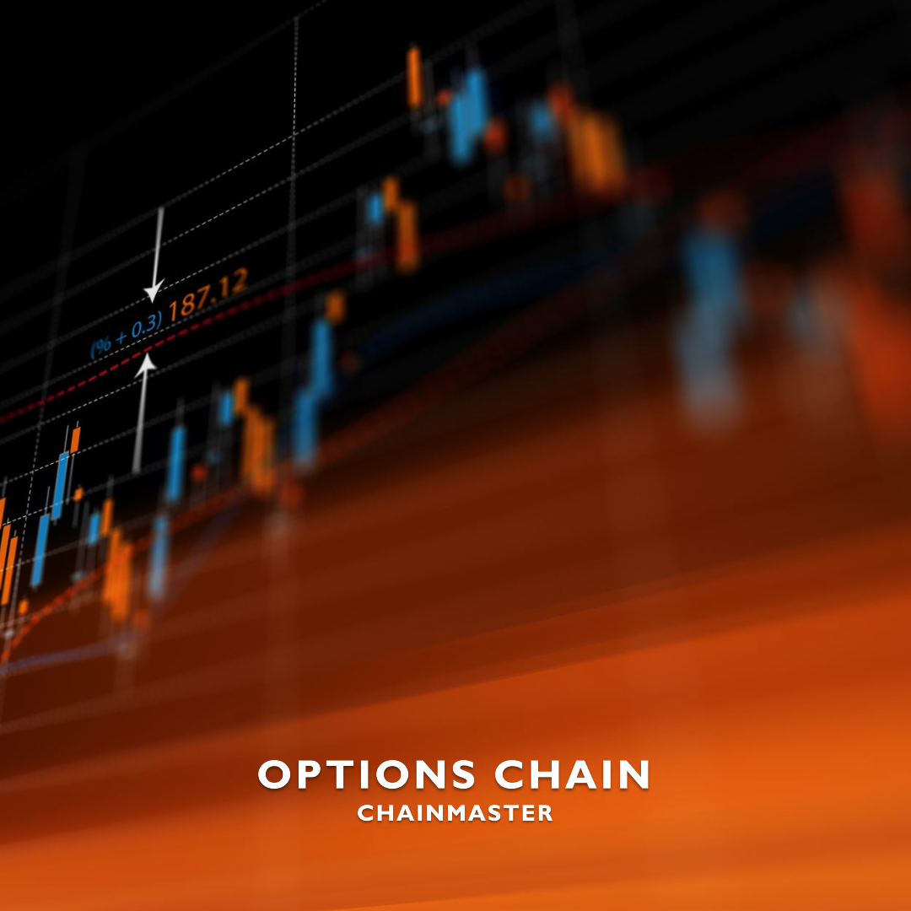
Introduction To Option Chains:
An options chain is a detailed listing of available option contracts for an underlying asset, enabling traders to analyze and strategize based on strike prices, expiration dates, and prices.
Key Components:
Underlying Asset
Expiration Dates
Strike Prices
Call and Put Options
Option Prices
Volume and Open Interest
Implied Volatility (IV)

Slide 4
Problem Statement:
Building a real-time Options Chain Platform/ Web Application with provided market data stream over TCP/IP, i.e a timeseries data stream with additional parameters like IV(Implied Volatility, calculated using Black Scholes), change in OI and Change reflecting on web screen accurately.
As the market data changes, the fields should be recalculated and refreshed on screen without having to reload on the browser.
To calculate Implied Volatility (IV) using Black Scholes Formula assuming risk free interest rate as 5%, calculating Time To maturity (TTM) assuming the expiry time to be at 15:30 IST on the expiry day.

Slide 5








Tech Stack:
Front-end:
Backend:
Version Control:

Slide 6

Our Approach
Step1
Intercept Little Endian encoded TCP stream using Node;Net TCPListener
Step2
Decode each packet, perform data engineering while calculating pertinent fields such as TTM, IV and extracting index LTPs
Step3
Establish a websocket server connection to relay real-time information stream. Implement Server Sent Events
Step4
Send stringified JSON packets to Websocket Client directly on the ReactJs Front-end
Step5
Display data packets without manual refresh on browser on an intuitive and user friendly Interface.

Slide 7
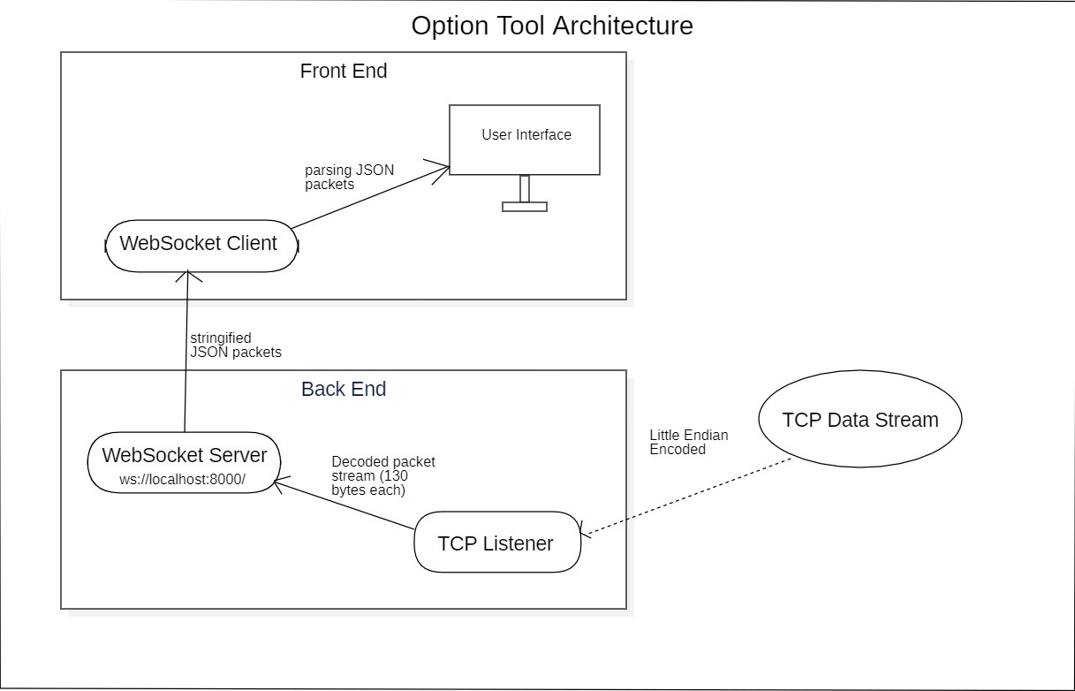
Our Approach

Slide 8




Top Features of Chain Masters
Features that make us unique
REAL-TIME UPDATES
SORTED DATA AND FILTERING
ASYNCHRONOUS PACKET UPDATION
SERVER SENT EVENTS USING WEBSOCKETS
Receives real-time market data updates.
Data is in sorted manner, provided filtering options.
Continuously process and handle data without manual refreshing.
Implemented SSE, enabling efficient and reliable communication.

Slide 9
Top Unique Features of Chain Masters
Real-time Updates: The webpage utilizes asynchronous web socket client to receive real-time market data updates, ensuring that the options page is continuously updated without the need for manual refreshing.
Sorted Data and Filtering: The options data is presented in a sorted manner, allowing users to easily analyze and compare different options. Additionally, the webpage provides filtering options to further refine the displayed data based on specific criteria.
Asynchronous Packet Updation: Our webpage is enabled to continuously process and handle incoming market data asynchronously, ensuring smooth and uninterrupted operation.
Server Sent Events using Websockets: The webpage leverages websockets to implement Server-Sent Events (SSE) functionality, enabling efficient and reliable communication between the server and the client. This allows for seamless data streaming and updates from the server to the webpage.

Slide 10
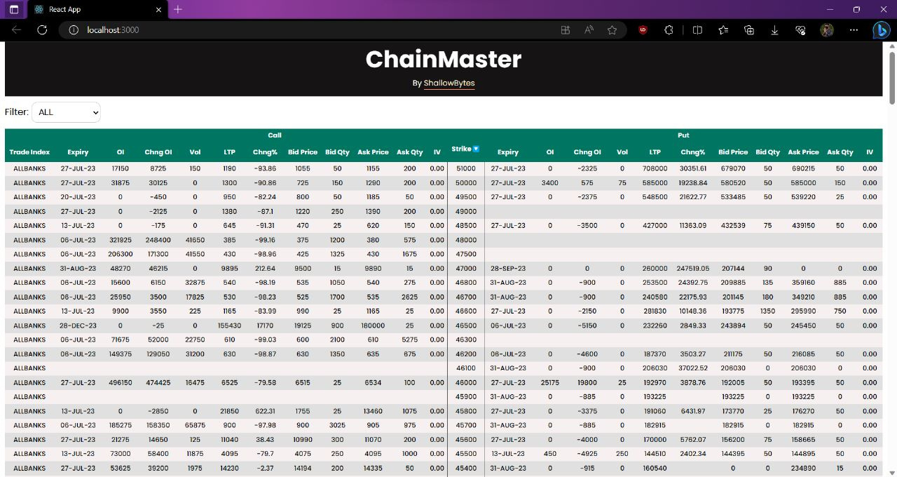
UI- ChainMaster

Slide 11

Github Repository link

